Slide 1


GROUP
ID COHORT 2024
WEEK 3
Megan Todd
Sr Instructional Designer

Slide 2


THIS WEEK
LEARNING OBJECTIVES
BLOOMS TAXONOMY
WE CAN DO HARD THINGS

Slide 3
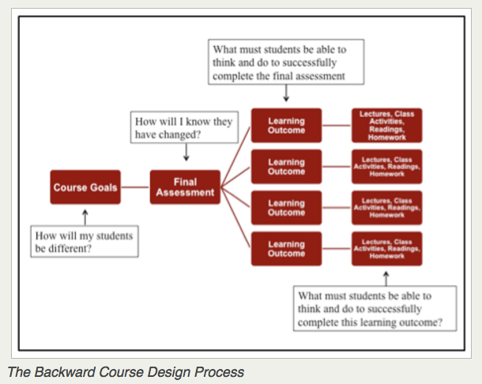


REVIEW - INSTRUCTIONAL DESIGN MODELS
BACKWARDS DESIGN
Starting with the goal first and moving backwards with barriers and limitations.
Pros: Realistic expectations, goal orientated, visually appealing and understandable
Cons: Need to build in time to adjust, not flexible, not focused on learner - more focused on program.
Notes:
U.S. copyright law provides copyright owners with the following exclusive rights:
Reproduce the work in copies or phonorecords.
Prepare derivative works based upon the work.
Distribute copies or phonorecords of the work to the public by sale or other transfer of ownership or by rental, lease, or lending.
Perform the work publicly if it is a literary, musical, dramatic, or choreographic work; a pantomime; or a motion picture or other audiovisual work.
Display the work publicly if it is a literary, musical, dramatic, or choreographic work; a pantomime; or a pictorial, graphic, or sculptural work. This right also applies to the individual images of a motion picture or other audiovisual work.
Perform the work publicly by means of a digital audio transmission if the work is a sound recording.
Copyright also provides the owner of copyright the right to authorize others to exercise these exclusive rights, subject to certain statutory limitations.

Slide 4

REVIEW - INSTRUCTIONAL DESIGN MODELS
YOUR TURN
I want this to be a collaborative experience.
Please remain respectful, kind, and clear with feedback. Remember we are all different levels and all learning.
Think in terms of
Content Clarity
Visibility -Design
Program Process - Job Aid
Notes:
U.S. copyright law provides copyright owners with the following exclusive rights:
Reproduce the work in copies or phonorecords.
Prepare derivative works based upon the work.
Distribute copies or phonorecords of the work to the public by sale or other transfer of ownership or by rental, lease, or lending.
Perform the work publicly if it is a literary, musical, dramatic, or choreographic work; a pantomime; or a motion picture or other audiovisual work.
Display the work publicly if it is a literary, musical, dramatic, or choreographic work; a pantomime; or a pictorial, graphic, or sculptural work. This right also applies to the individual images of a motion picture or other audiovisual work.
Perform the work publicly by means of a digital audio transmission if the work is a sound recording.
Copyright also provides the owner of copyright the right to authorize others to exercise these exclusive rights, subject to certain statutory limitations.

Slide 5


THE
ADDIE
MODEL
1
ANALYSIS
  Define goals and objective
  collect necessary data
  Define audience
2
DESIGN
Identify the desired learning outcomes,
craft the structure, determine the duration and sequence the course.
3
DEVELOPMENT
Collaborating with programmers, videographers, audio talents, and editors to bring our team's design to life.
4
IMPLEMENTATION
The course is delivered to its audience with all training resources available.
5
EVALUATION
Evaluate the effectiveness of the course by measuring the audience's level of learning and retention, as well as the success of the projects in achieving their goals.
PROS: step-by-step process, adaptability, identify learner needs and objectives, and allow for feedback.
CONS: too linear, time consuming and expensive.

Slide 6


ASSURE MODEL
A - ANALYZE LEARNERS
Research characteristics of learners. Learning styles/preferences
S-STATE OBJECTIVES
Develop specific and measurable objectives.
S- SELECT MEDIA AND MATERIALS
Gather materials and media. Develop/modify existing materials.
U - UTILIZE MEDIA AND MATERIALS
Pilot test media/materials. Implement the material.
R- REQUIRE LEARNER PARTICIPATION
Elicit participation. Discussions/games/simulations
E- EVALUATE AND REVISE
Were objectives met? Edit and revise content
PROS
Listens to learners. Utilizes technology, Provides guidance
CONS
Too focused on academic setting. Narrow scope.
Time consuming
www.reallygreatsite.com

Slide 7













RISE Partnership Quality Assurance Plan
Key Points to Focus During Quality Review of Cultural Awareness
Team acknowledgment of variations in style/time constraints/OHCC content
Best practice or personal style with facilitation that is still approved by OHCC
Build momentum with editorial team
Peer review of facilitation including curriculum team, trainers, QA lead
Time for trainers to roll out the standard for cultural awareness facilitation-measure and reporting
QA team provide update to editorial team and focus on future QA points
Action Steps for QA team
Trial QA process for 20024-2025 plan
Trainer satisfaction
metrics
Trainers highlight own guides showing theme weaving, audience FAC style, content skipped/paraphrased, areas of question
Identify editorial team of trainers, A rep,
curriculum
January 2024 two peer reviewed FAC
with editorial team per month
Curriculum/QA team/leadership review
and report of standard starting March
2024
Measure amount of OHCC content
altered to trainer style and content
omitted
Develop trainer survey post process to
measure satisfaction
Goals
Develop standard for
learner expereince/ facilitation

Slide 8
Future QA focus points for further discussion
▪
Increased supervisor observations of New Worker Orientation, in person and virtually.
▪
Once a month 30 minutes at end of delivery team meeting for trainers to discuss helpful hints,
challenges with FAC/MOD style and standard.
▪
Learner surveys post Cultural awareness and New Worker Orientation.
▪
Notes, metrics, action item updates to be organized by QA team.
Feedback/Notes

Slide 9
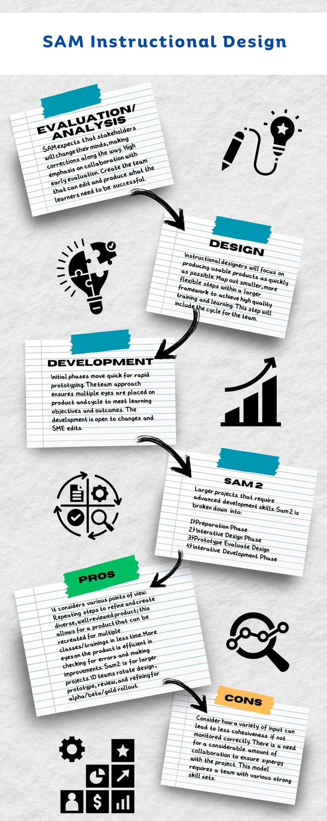

Slide 10
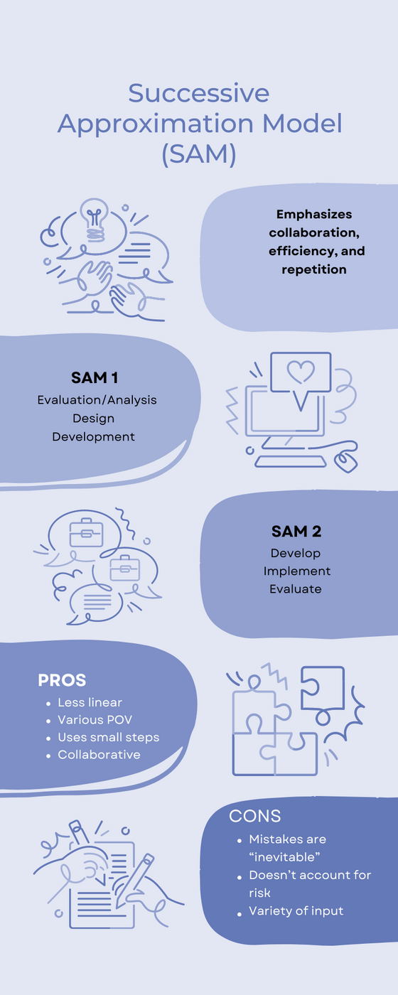

Slide 11







REVIEW - RESEARCH
WEBSITES/
ARTICLE
DATES
STATE RESOURCES
LIBRARY
Oregon State website
Oregon Heath Authority
OHCC
Oregon Library
Library of Congress
Most relevant
10 years or less
20 scholarly
.edu
.gov
.org
Notes:
• State resources, .org
• Educational resources .edu
• Library research
• Scholarly articles
o Goal less than 10 years
o How to read
o How to find
• Reputable websites/articles
o 5-10 years
• How to site materials in e-Learning
o APA
• Copyright

Slide 12



APA CITING
NAME, TITLE, DATE
APA GENERATOR
Generator
Notes:
https://elearningindustry.com/the-future-of-elearning-emerging-technologies-and-trends-to-watch.
With the covid-19 outbreak, online learning came into the spotlight. The inaccessibility of traditional classrooms exposed the students to online learning and some of its demerits. Any crowd-engaging events or activities were banned to avoid spreading covid, and the lockdown forced everyone to enroll in online learning.
The Pandemic introduced us to the significant role of technology and eLearning in modern lives. It also opened the doors of technology-driven future education, and eLearning is now the only way forward.

Slide 13

THOERY
MOST COMMON
  Constructivism
  Behaviorism
  Cognitivism
  Andragony
Notes:
nstructional design models and theories have different but complementary roles in education and training. Models are like blueprints. They are practical, step-by-step guides for creating learning materials. They outline stages like analysis, design, development, implementation, and evaluation. For instance, ADDIE is a popular model that helps practitioners create effective learning content. Theories, on the other hand, explain why people learn and provide insights into designing instruction. They are based on psychology, cognitive science, and behavior. For example, Andragogy focuses on the unique characteristics and motivations of adult learners. In short, models are practical tools that show how to design, while theories explain why learning works. Both are vital for instructional designers to create effective learning experiences.

Slide 14
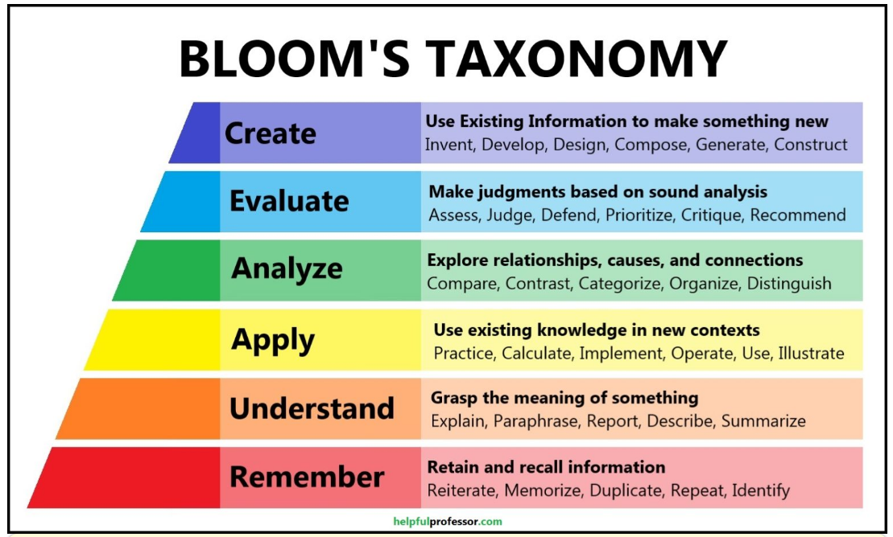
Notes:
https://elearningindustry.com/the-future-of-elearning-emerging-technologies-and-trends-to-watch.
With the covid-19 outbreak, online learning came into the spotlight. The inaccessibility of traditional classrooms exposed the students to online learning and some of its demerits. Any crowd-engaging events or activities were banned to avoid spreading covid, and the lockdown forced everyone to enroll in online learning.
The Pandemic introduced us to the significant role of technology and eLearning in modern lives. It also opened the doors of technology-driven future education, and eLearning is now the only way forward.

Slide 15
Create Learning objectives for a course about Anxiety to State Workers of Oregon.
Describe symptoms and treatments for anxiety.
Explain how to deal with anxiety in the workplace.
Notes:
https://elearningindustry.com/the-future-of-elearning-emerging-technologies-and-trends-to-watch.
With the covid-19 outbreak, online learning came into the spotlight. The inaccessibility of traditional classrooms exposed the students to online learning and some of its demerits. Any crowd-engaging events or activities were banned to avoid spreading covid, and the lockdown forced everyone to enroll in online learning.
The Pandemic introduced us to the significant role of technology and eLearning in modern lives. It also opened the doors of technology-driven future education, and eLearning is now the only way forward.

Slide 16




THIS WEEK
READING
  Developing Course-Level Learning Objectives4.ppt
  https://revadigital.com/2016/10/31/benefits-defining-learning-objectives-outcome-corporate-training/
  https://www.celt.iastate.edu/instructional-strategies/preparing-to-teach/tips-on-writing-course-goalslearning-outcomes-and-measureable-learning-objectives/
  https://cft.vanderbilt.edu/guides-sub-pages/blooms-taxonomy/
  Play with outcome generator to help alleviate writers block.
    https://cdl.ucf.edu/teach/resources/objective-builder-tool/
BOOK
VIDEOS
  Chapter 8 – Learning Objectives pg. 100 – 11
  https://www.youtube.com/watch?v=i5xGYRig_hY
  https://www.youtube.com/watch?v=QXGOjzcQdhQ
  https://www.youtube.com/watch?v=ayefSTAnCR8

Slide 17


SCENARIOS
Practice creating learning objectives based off SME recommendations.
  Create Learning objectives for a course about Anxiety to state Workers of Oregon.
  Create Learning objectives for a course about Oral hygiene to Personal Support Workers supporting their consumers in Oregon.
  Create Learning Objectives for Cultural Sensitivities for a course for local high school students in the Portland Metro Area.
ACTIVITY
WRITE LEARNING OBJECTIVES

Slide 18

QUESTIONS
MOST COMMON
  What was your experience having little to no information about a course you had to develop learning outcomes for?
  Did Bloom’s taxonomy help?
  Does blooms taxonomy change the way you think about developing courses.
Notes:
nstructional design models and theories have different but complementary roles in education and training. Models are like blueprints. They are practical, step-by-step guides for creating learning materials. They outline stages like analysis, design, development, implementation, and evaluation. For instance, ADDIE is a popular model that helps practitioners create effective learning content. Theories, on the other hand, explain why people learn and provide insights into designing instruction. They are based on psychology, cognitive science, and behavior. For example, Andragogy focuses on the unique characteristics and motivations of adult learners. In short, models are practical tools that show how to design, while theories explain why learning works. Both are vital for instructional designers to create effective learning experiences.

Slide 19
UPCOMING
ACCESIBILITY

