Slide 1


GROUP
ID COHORT 2024
WEEK 8
Megan Todd
Sr Instructional Designer

Slide 2


THIS WEEK
EMPATHY MAP
INTERACTIONS
ASSESSMENT QUESTIONS
WE CAN DO HARD THINGS

Slide 3




REVIEW EMPATHY MAP
Thinks
Feels
Does
Says

Slide 4
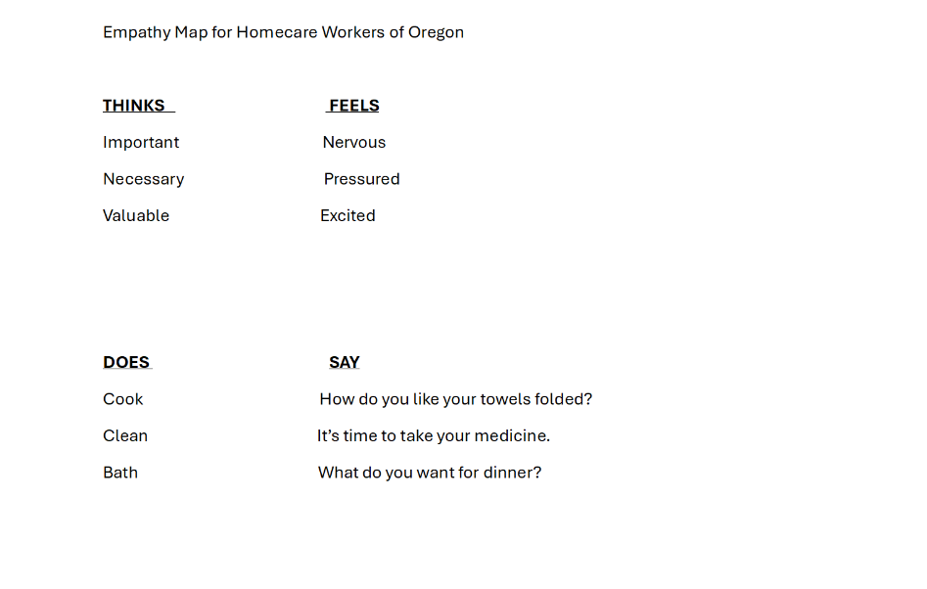

Slide 5
Thinks
Feels
Does
Says

Slide 6



REVIEW INTERACTIONS
ENGAGE THE LEARNER
  Click to reveal
  Drag and Drop
  Put in Order

Slide 7
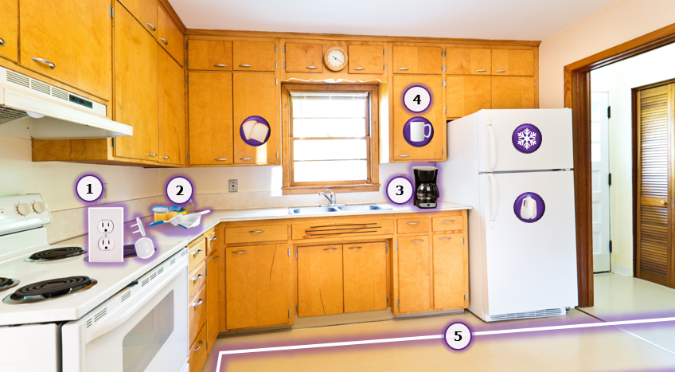

Slide 8
Dev note: Layer 2. Buttons and outlines appear after intro VO. Pop-up text appears when learner hovers over objects.
VO: Notice this kitchen is clean, well lit, and free of trip hazards. Click on each object to explore solutions for ease of use and enhancing safety.
User clicks #1: Wall outlet and covers pop out.
•Pop-up screen text: Covering wall outlets reduces risk for persons with dementia.
User clicks #2: Coffee maker pops out.
•Pop-up screen text: Small appliances pose a hazard.
User clicks #3: Cleaning supplies pop out.
•Pop-up screen text: Cleaning products within reach can be dangerous.
User clicks #4: Cabinet and refrigerator labels appear. Hover to enlarge.
•Pop-up screen text: Labels with pictures help the person find what they need.
•
User clicks #5: Lines along floor appear.
•Pop-up screen text: Taping a path on the floor aids wayfinding and reduces confusion.
VO: These are recommendations, not requirements. Remember never to alter the person’s space in any way without talking to them first, and always respect their choices.

Slide 9
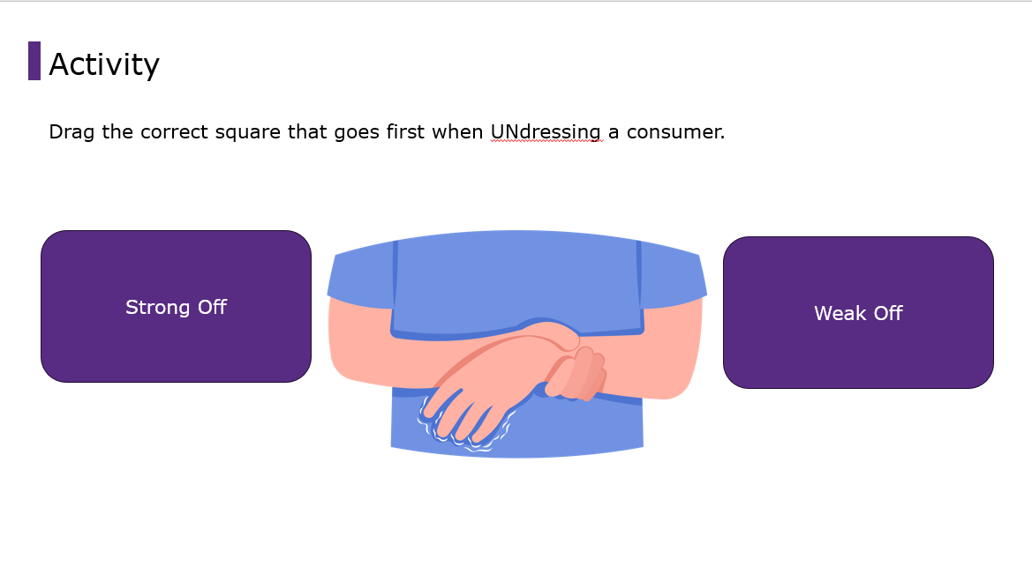

Slide 10
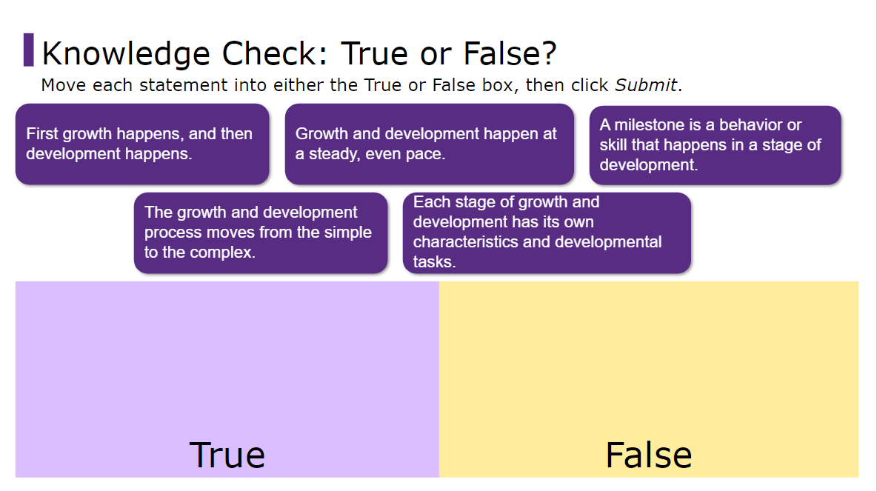

Slide 11

ASSESSMENTS
FORMATIVE
SUMMATIVE
PEER
SELF

Slide 12


ACTIVITY
CREATE AND FIX ASSESSMENT QUESTIONS
  Create an assessment with 10 questions about In Person or Webinar Orientation for Homecare, Personal Support, or Personal Care Attendants. Don’t repeat any current questions.
  Fix these assessment questions. Provide reasons why these are bad assessment questions and how you fixed it.
    1.Which of the following is the most likely explanation for these findings?
    2.Which of the following is the most appropriate next step of the process?
    3.Which answer is correct?
      a.B
      b.A
      c.All of the above
      d.None of the above
    4.Which management strategy is most effective for Rise?

Slide 13
ACTIVITY
CREATE AND FIX ASSESSMENT QUESTIONS, CONT.
5.Which of the following statements is correct?
    a.Ross are red
    b.Violets are blue
    c.The answer is here
    d.How do you do
6.When does the sun NOT set in the west?
7.Sarah and Emily are sisters and next door neighbors in the nursing home. Sarah looks a little more sad han usual today. You ask her where’s Emily and she says she doesn’t know. What should you do next?
    a.Go talk to Emily
    b.Get medications ready
    c.Ask Sarah if she wants to talk about it?

Slide 14


GRAPHICS
TYPES
CONSIDERATIONS
  Images
  Clip Art
  Cartoons
  Accents
  Quality vs quantity
  Consistency
  Photos vs graphic
  Tailor/ reflective to the learner

Slide 15

ACTIVITY
FIND IMAGES FOR...
  Select an image of children learning, emphasis on math, outside.
  Select an image that evokes compassion.
  Select an image for scheduling and appointment.
  Select an image that represents Rise?
  Select an image for sensitive.
Answer:
  Why did you select this image?
  Provide alt text description you would include with the image.

Slide 16


Slide 17


Slide 18
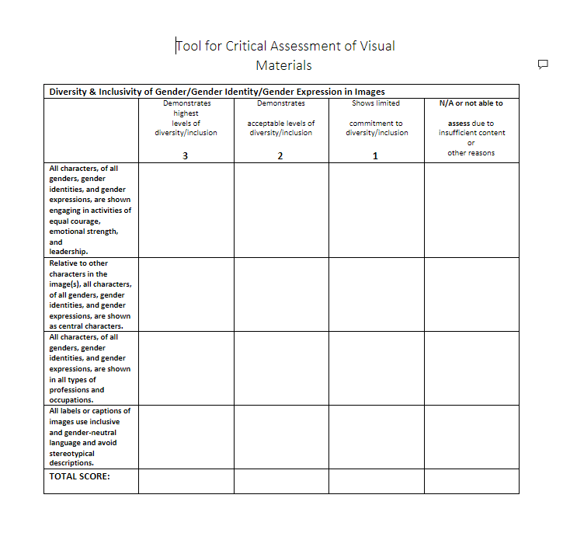
ACTIVITY

Slide 20



THIS WEEK
READING
  https://www.youtube.com/watch?v=yzSlvcmiABw
  https://risepartnership.sharepoint.com/:w:/r/sites/Curriculum_Services-CSTeamDevelopmentMaterials/_layouts/15/Doc.aspx?sourcedoc=%7B9689119E-28BE-43BA-95EA-BF2B20A92A00%7D&file=Tool%20for%20Critical%20Assessment%20of%20Visual%20Materials.docx&wdOrigin=TEAMS-ELECTRON.p2p_ns.bim&action=default&mobileredirect=true
  116 tips- elearning-commlab – read slides 15 - 30
  WhiteSpaceIsNotYourEnemy.pdf
  https://elearningindustry.com/images-in-elearning-6-best-practices-to-choose-images-for-your-elearning-course
  https://elearningindustry.com/7-tips-to-choose-images-and-graphics-for-elearning-course
  Rise brand Book – Skim through
BOOK
VIDEOS
  Go to Minute 45 and listen until 1.13 Selecting Images
  https://www.youtube.com/watch?v=eRK-VIopbA4&t=1s
  Chapter 22 – Graphics pg 276 -284

Slide 21
UPCOMING
Video and Audio

