Slide 1


ID COHORT 2024
WEEK 5
Megan Todd
Sr Instructional Designer

Slide 2


THIS WEEK
INTERACTIONS
EMPATHY MAP
WE CAN DO HARD THINGS

Slide 3



INTERACTIONS
ENGAGE THE LEARNER
  Click to reveal
  Drag and Drop
  Put in Order
Notes:
U.S. copyright law provides copyright owners with the following exclusive rights:
Reproduce the work in copies or phonorecords.
Prepare derivative works based upon the work.
Distribute copies or phonorecords of the work to the public by sale or other transfer of ownership or by rental, lease, or lending.
Perform the work publicly if it is a literary, musical, dramatic, or choreographic work; a pantomime; or a motion picture or other audiovisual work.
Display the work publicly if it is a literary, musical, dramatic, or choreographic work; a pantomime; or a pictorial, graphic, or sculptural work. This right also applies to the individual images of a motion picture or other audiovisual work.
Perform the work publicly by means of a digital audio transmission if the work is a sound recording.
Copyright also provides the owner of copyright the right to authorize others to exercise these exclusive rights, subject to certain statutory limitations.

Slide 4
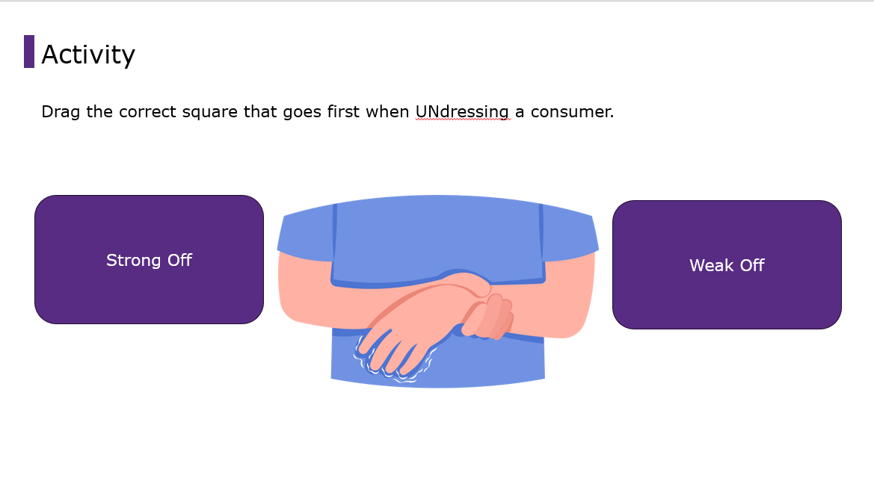

Slide 5
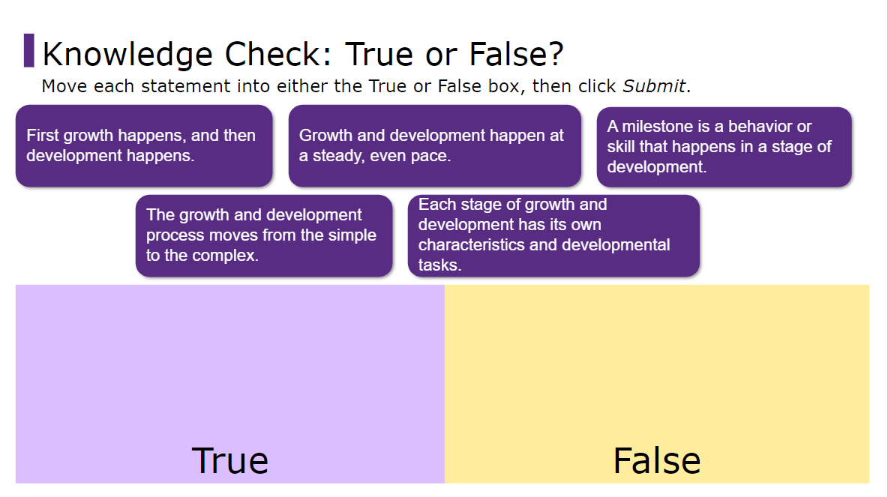

Slide 6
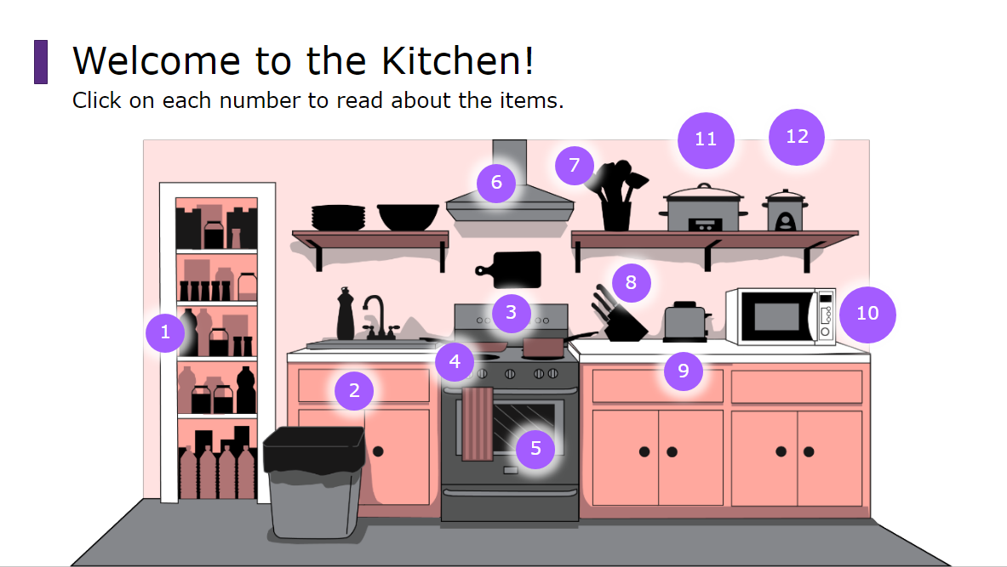

Slide 7




EMPATHY MAP
Thinks
Feels
Does
Says
Notes:
https://elearningindustry.com/the-future-of-elearning-emerging-technologies-and-trends-to-watch.
With the covid-19 outbreak, online learning came into the spotlight. The inaccessibility of traditional classrooms exposed the students to online learning and some of its demerits. Any crowd-engaging events or activities were banned to avoid spreading covid, and the lockdown forced everyone to enroll in online learning.
The Pandemic introduced us to the significant role of technology and eLearning in modern lives. It also opened the doors of technology-driven future education, and eLearning is now the only way forward.

Slide 8





THIS WEEK
READING
  EngagingInteractionsForELearning.pdf
  https://community.articulate.com/articles/common-elearning-interactions-and-examples
  https://community.articulate.com/series/engage-360-understanding-interaction-types/articles/engage-360-accordion-interactions
BOOK
VIDEOS
  https://www.youtube.com/watch?v=QwF9a56WFWA&t=208s
  https://www.youtube.com/watch?v=dCIfpHiEwFo
  https://www.youtube.com/watch?v=4cbf7P92nAk
  https://www.youtube.com/watch?v=lbglmmX43Ws
  https://www.youtube.com/watch?v=VQ4D7co2DEg
  Chapter 29 - Copyright pg 350 - 363
  Chapter 14 – Implementation pg. 160 – 178

Slide 9



  Create an empathy map for Homecare Workers of Oregon.
  Create 4 Learning Interactions
    In person Learning Activity
    Webinar
    2 PowerPoint Interactions for eLearning course
      1 Scenario
      1 other
        Drag and Drop
        Click to reveal
        Ect
ACTIVITY
INTERACTIONS AND
EMPATHY MAP

Slide 10
UPCOMING
Evaluation
Assessment

