Slide 1


ID COHORT 2024
WEEK 9
Megan Todd
Sr Instructional Designer

Slide 2


THIS WEEK
WEB LEARNING
WE CAN DO HARD THINGS

Slide 3
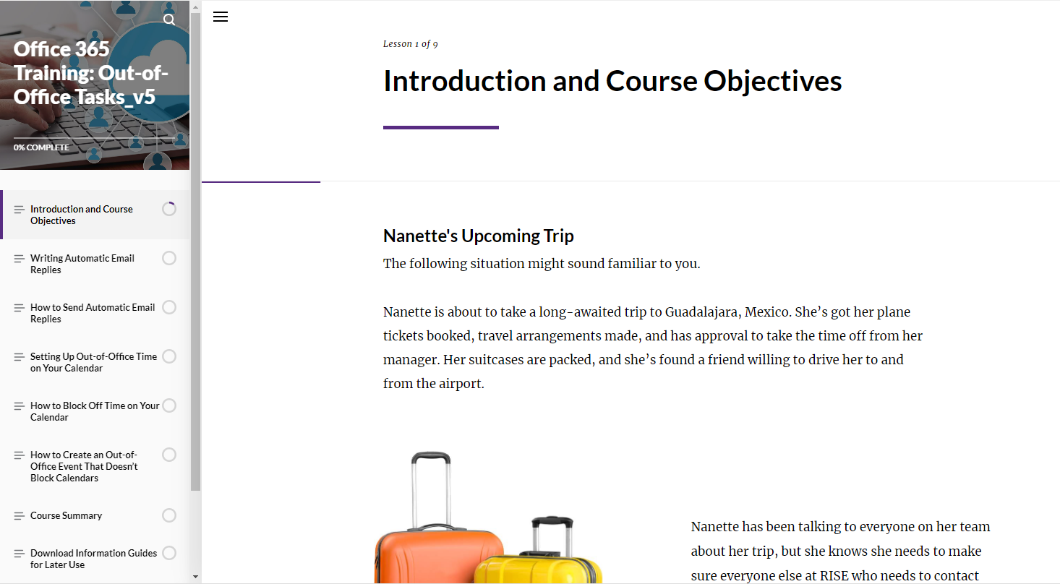


WEB-BASED
RISE 360
  RISE beginning to use
  Interactive website
  Activities
    Flashcards
    Timeline
    Matching
Notes:
U.S. copyright law provides copyright owners with the following exclusive rights:
Reproduce the work in copies or phonorecords.
Prepare derivative works based upon the work.
Distribute copies or phonorecords of the work to the public by sale or other transfer of ownership or by rental, lease, or lending.
Perform the work publicly if it is a literary, musical, dramatic, or choreographic work; a pantomime; or a motion picture or other audiovisual work.
Display the work publicly if it is a literary, musical, dramatic, or choreographic work; a pantomime; or a pictorial, graphic, or sculptural work. This right also applies to the individual images of a motion picture or other audiovisual work.
Perform the work publicly by means of a digital audio transmission if the work is a sound recording.
Copyright also provides the owner of copyright the right to authorize others to exercise these exclusive rights, subject to certain statutory limitations.

Slide 4
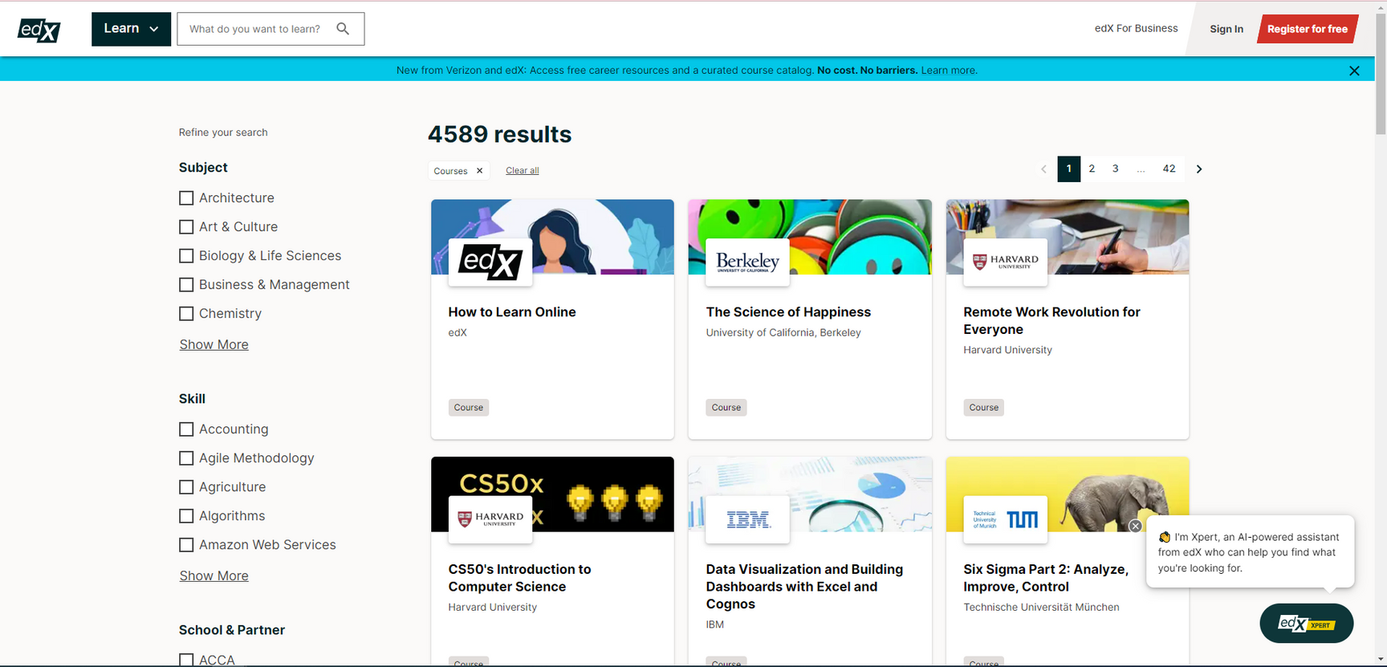
MOOC
MASSIVE OPEN ONLINE COURSE
  Free online courses
  For the masses
  edX, LinkedIn
Notes:
U.S. copyright law provides copyright owners with the following exclusive rights:
Reproduce the work in copies or phonorecords.
Prepare derivative works based upon the work.
Distribute copies or phonorecords of the work to the public by sale or other transfer of ownership or by rental, lease, or lending.
Perform the work publicly if it is a literary, musical, dramatic, or choreographic work; a pantomime; or a motion picture or other audiovisual work.
Display the work publicly if it is a literary, musical, dramatic, or choreographic work; a pantomime; or a pictorial, graphic, or sculptural work. This right also applies to the individual images of a motion picture or other audiovisual work.
Perform the work publicly by means of a digital audio transmission if the work is a sound recording.
Copyright also provides the owner of copyright the right to authorize others to exercise these exclusive rights, subject to certain statutory limitations.

Slide 5





THIS WEEK
READING
  Designing effective online courses
  Beginners guide to Online training
  Potential of online learning
  https://www.edsurge.com/news/2020-08-15-what-workforce-education-is-learning-from-the-pandemic
  https://docs.moodle.org/34/en/Pedagogy#Definition_of_Pedagogy
BOOK
VIDEOS
  https://www.youtube.com/watch?v=-sPkZwqh2Ck
  Chapter 27 – Web 2.0 pg. 329 - 342

Slide 6

ACTIVITY
Review the following web based learning and answer the following questions
https://360.articulate.com/review/content/bbc92a67-977c-4c34-b92e-291e5c63fb75/review
Question: How would you organize your course differently for a web-based online course vs online modules.

Slide 7
ACTIVITY, CONT.
Find an online course (recommendations below) that you would recommend as a good web based learning example.
  EdX – Best Overall
  Coursera – Best Language Variety
  FutureLearn – Best for STEM Courses
  Codecademy – Best for Coding Courses
  Udacity – Best for IT Courses
  Memrise – Best for Foreign Language Courses
  Udemy – Best for Business Courses
Question:
Why is it good in your opinion?

Slide 8
UPCOMING
Mobile Learning

