Slide 1


ID COHORT 2024
WEEK 7
Megan Todd
Sr Instructional Designer

Slide 2


THIS WEEK
ACCESSIBILITY, CONT.
GRAPHICS
WE CAN DO HARD THINGS

Slide 3



ACCESIBILITY
PLL
DEIJ
  English version piloted and edited
  Interpro
  Trainers
  Critical Assessment of Visuals
  DEIJ committee
Notes:
U.S. copyright law provides copyright owners with the following exclusive rights:
Reproduce the work in copies or phonorecords.
Prepare derivative works based upon the work.
Distribute copies or phonorecords of the work to the public by sale or other transfer of ownership or by rental, lease, or lending.
Perform the work publicly if it is a literary, musical, dramatic, or choreographic work; a pantomime; or a motion picture or other audiovisual work.
Display the work publicly if it is a literary, musical, dramatic, or choreographic work; a pantomime; or a pictorial, graphic, or sculptural work. This right also applies to the individual images of a motion picture or other audiovisual work.
Perform the work publicly by means of a digital audio transmission if the work is a sound recording.
Copyright also provides the owner of copyright the right to authorize others to exercise these exclusive rights, subject to certain statutory limitations.

Slide 4


GRAPHICS
TYPES
CONSIDERATIONS
  Images
  Clip Art
  Cartoons
  Accents
  Quality vs quantity
  Consistency
  Photos vs graphic
  Tailor/ reflective to the learner
Notes:
U.S. copyright law provides copyright owners with the following exclusive rights:
Reproduce the work in copies or phonorecords.
Prepare derivative works based upon the work.
Distribute copies or phonorecords of the work to the public by sale or other transfer of ownership or by rental, lease, or lending.
Perform the work publicly if it is a literary, musical, dramatic, or choreographic work; a pantomime; or a motion picture or other audiovisual work.
Display the work publicly if it is a literary, musical, dramatic, or choreographic work; a pantomime; or a pictorial, graphic, or sculptural work. This right also applies to the individual images of a motion picture or other audiovisual work.
Perform the work publicly by means of a digital audio transmission if the work is a sound recording.
Copyright also provides the owner of copyright the right to authorize others to exercise these exclusive rights, subject to certain statutory limitations.

Slide 5



RISE
Notes:
U.S. copyright law provides copyright owners with the following exclusive rights:
Reproduce the work in copies or phonorecords.
Prepare derivative works based upon the work.
Distribute copies or phonorecords of the work to the public by sale or other transfer of ownership or by rental, lease, or lending.
Perform the work publicly if it is a literary, musical, dramatic, or choreographic work; a pantomime; or a motion picture or other audiovisual work.
Display the work publicly if it is a literary, musical, dramatic, or choreographic work; a pantomime; or a pictorial, graphic, or sculptural work. This right also applies to the individual images of a motion picture or other audiovisual work.
Perform the work publicly by means of a digital audio transmission if the work is a sound recording.
Copyright also provides the owner of copyright the right to authorize others to exercise these exclusive rights, subject to certain statutory limitations.

Slide 6





THIS WEEK
READING
  https://www.youtube.com/watch?v=yzSlvcmiABw
  https://risepartnership.sharepoint.com/:w:/r/sites/Curriculum_Services-CSTeamDevelopmentMaterials/_layouts/15/Doc.aspx?sourcedoc=%7B9689119E-28BE-43BA-95EA-BF2B20A92A00%7D&file=Tool%20for%20Critical%20Assessment%20of%20Visual%20Materials.docx&wdOrigin=TEAMS-ELECTRON.p2p_ns.bim&action=default&mobileredirect=true
  116 tips- elearning-commlab – read slides 15 - 30
  WhiteSpaceIsNotYourEnemy.pdf
  https://elearningindustry.com/images-in-elearning-6-best-practices-to-choose-images-for-your-elearning-course
  https://elearningindustry.com/7-tips-to-choose-images-and-graphics-for-elearning-course
  Rise brand Book – Skim through
BOOK
VIDEOS
  Go to Minute 45 and listen until 1.13 Selecting Images
  https://www.youtube.com/watch?v=eRK-VIopbA4&t=1s
  Chapter 22 – Graphics pg 276 -284

Slide 7
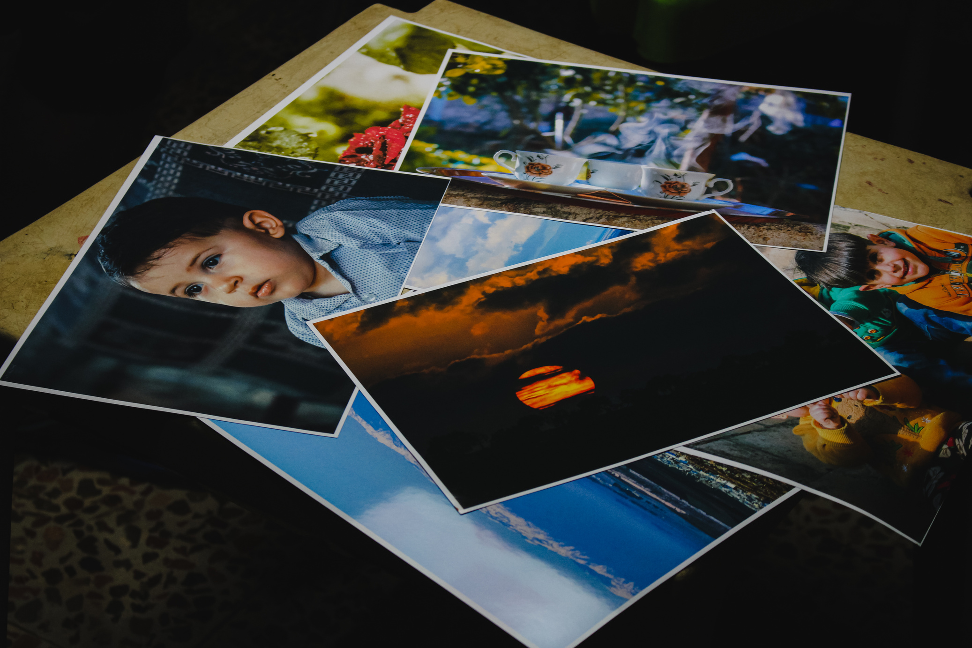

ACTIVITY
FIND IMAGES FOR...
  Select an image of children learning, emphasis on math, outside.
  Select an image that evokes compassion.
  Select an image for scheduling and appointment.
  Select an image that represents Rise?
  Select an image for sensitive.
Answer:
  Why did you select this image?
  Provide alt text description you would include with the image.

Slide 8
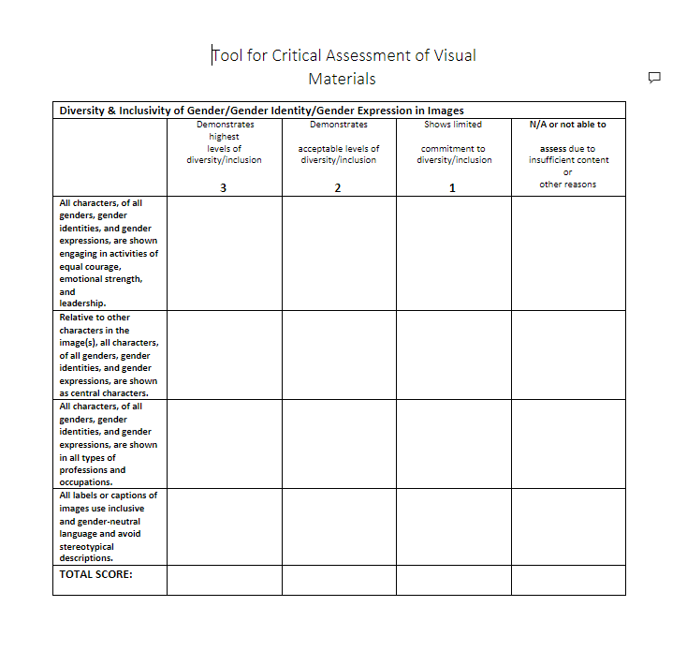
ACTIVITY
TOOL FOR CRITICAL ASSESSMENT
  Take image through the Tool for Critical Assessment of Visual Materials.

Slide 9

QUESTION
  Was it easier or harder to find images?
  What considerations are you taking into account when searching.
  What did you learn about your image selection using the Tool for Critical Assessment?

Slide 10
UPCOMING
Video and Audio

